Slide 1
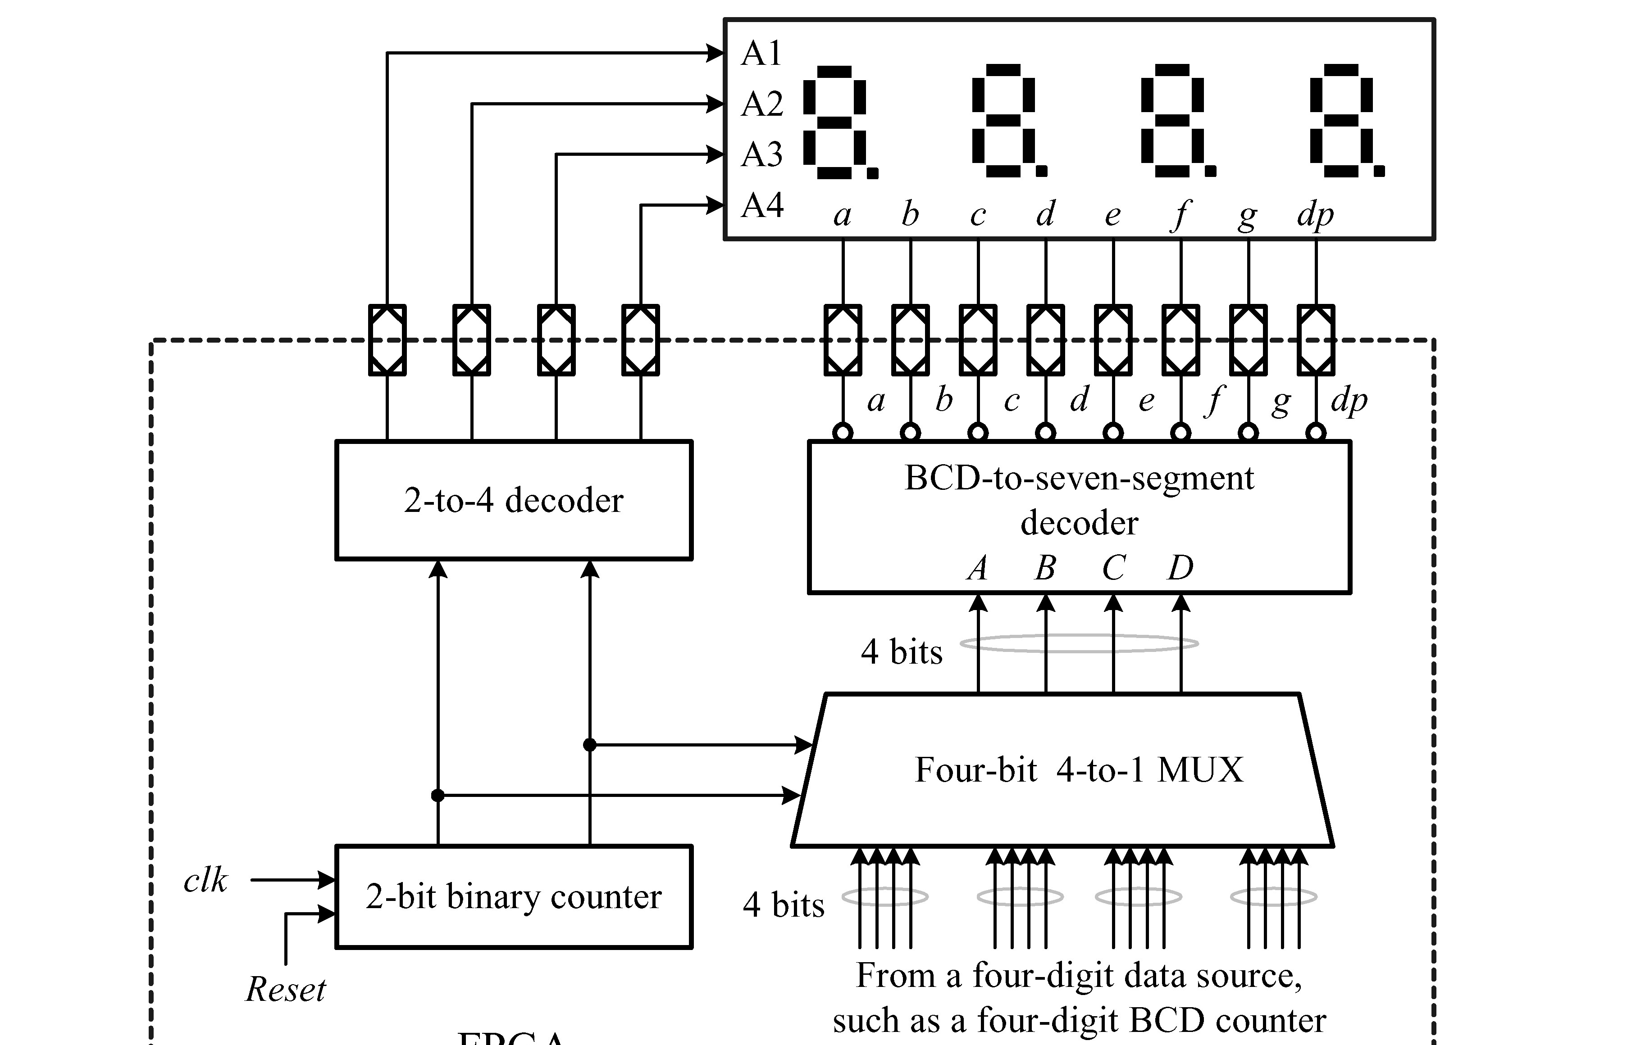
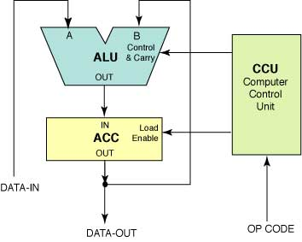
Homework 3
(HW-2)
Binary-to-BCD Converter
0000~0FFF(H)
X, Y = 0~2¹²-1(B)

Slide 2
ALU (Arithmetic Logic Unit) Design
Design an 8-function ALU that takes two 13-bit numbers d1 and d2 and computes a 13-bit result out based on a 3-bit OPCODE signal. If result=0, Status has to output 1. (no overflow, negative number)
OPCODE | Function Output
3’b000 | No operation
3’b001 | a+b
3’b010 | a-b
3’b011 | a/b
3’b100 | a%b (remainder)
3’b101 | (a>b)
3’b110 | a<<1
3’b111 | a
reset

Slide 3
ALU (Arithmetic Logic Unit) module 4
module alu (aclk, mdat, acc_out, opcd, alu_out, zr);
input aclk; input [12:0] mdat, acc_out; input [2:0] opcd;
output [12:0] alu_out; output zr;
reg [7:0] a, alu_out; wire zr;
always @ ( posedge aclk ) begin case (opcd) 3'b000 : begin a <= acc_out; end
3'b001 : begin a <= acc_out; end
3'b010 : begin a <= {mdat + acc_out}; end
3'b011 : begin a <= {mdat & acc_out}; end
3'b100 : begin a <= {mdat ^ acc_out}; end
3'b101 : begin a <= mdat; end
3'b110 : begin a <= acc_out; end
3'b111 : begin a <= acc_out; end
default : begin a <= 0; end
endcase end
assign alu_out = a;
assign zr = &(a);
endmodule

Slide 4
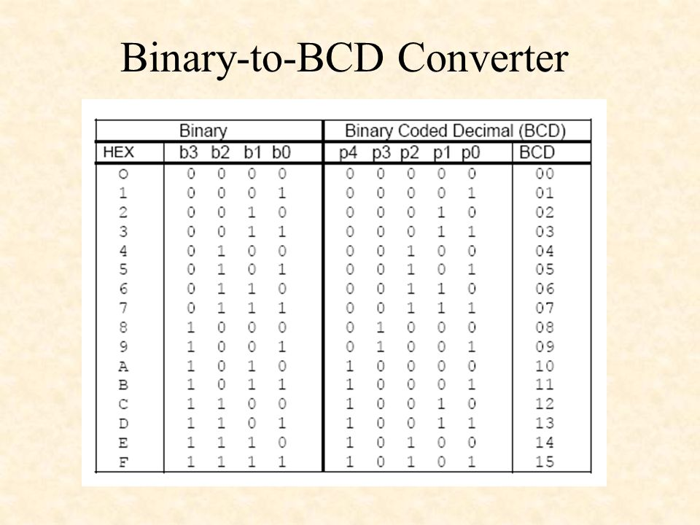

Slide 5
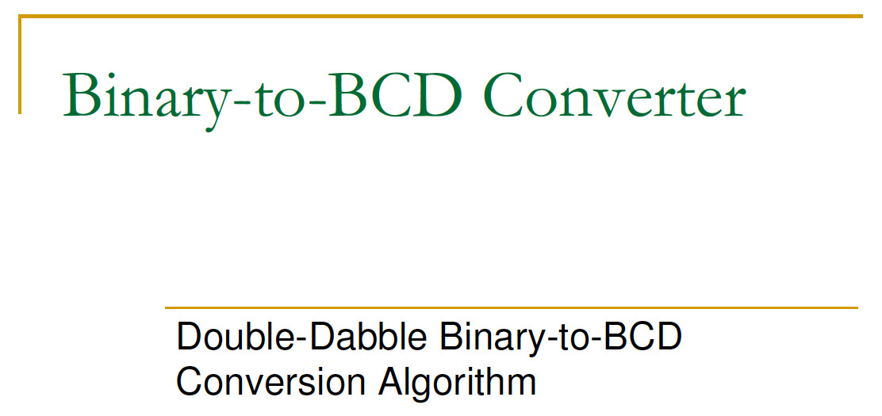

Slide 6
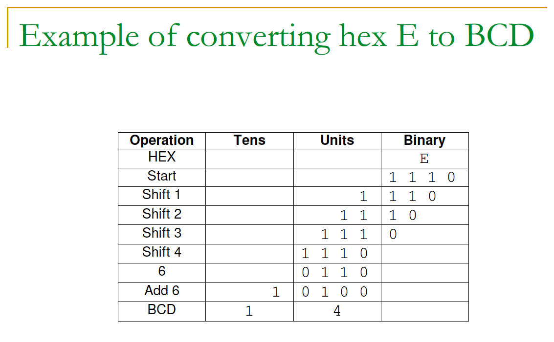
Check >??
Check >9

Slide 7
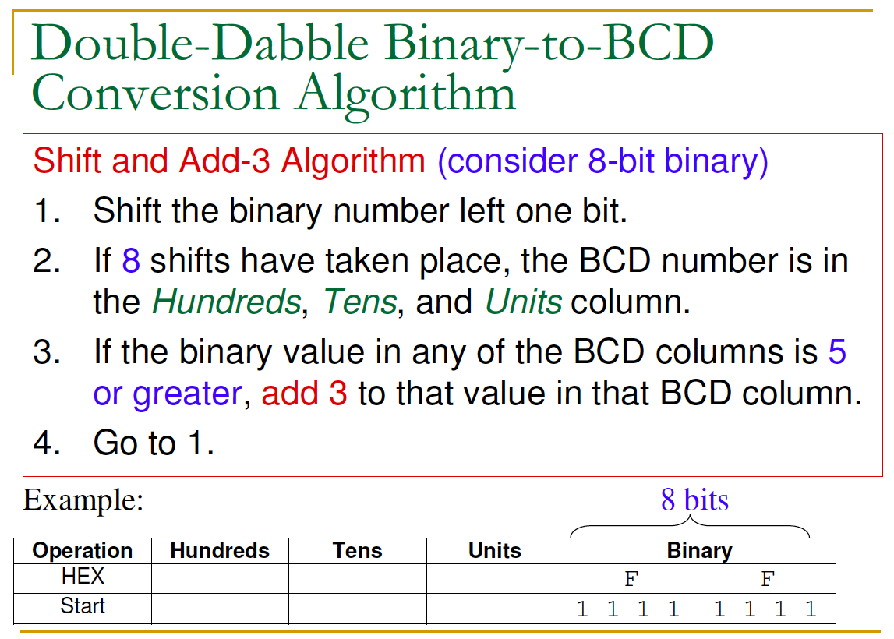
1

Slide 8
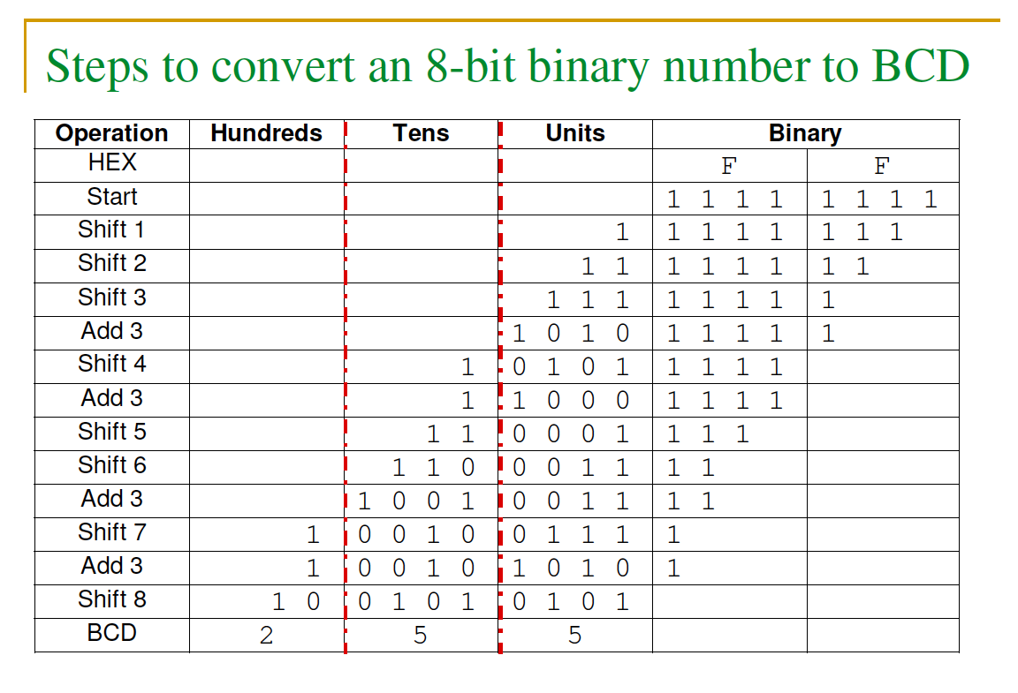

Slide 10
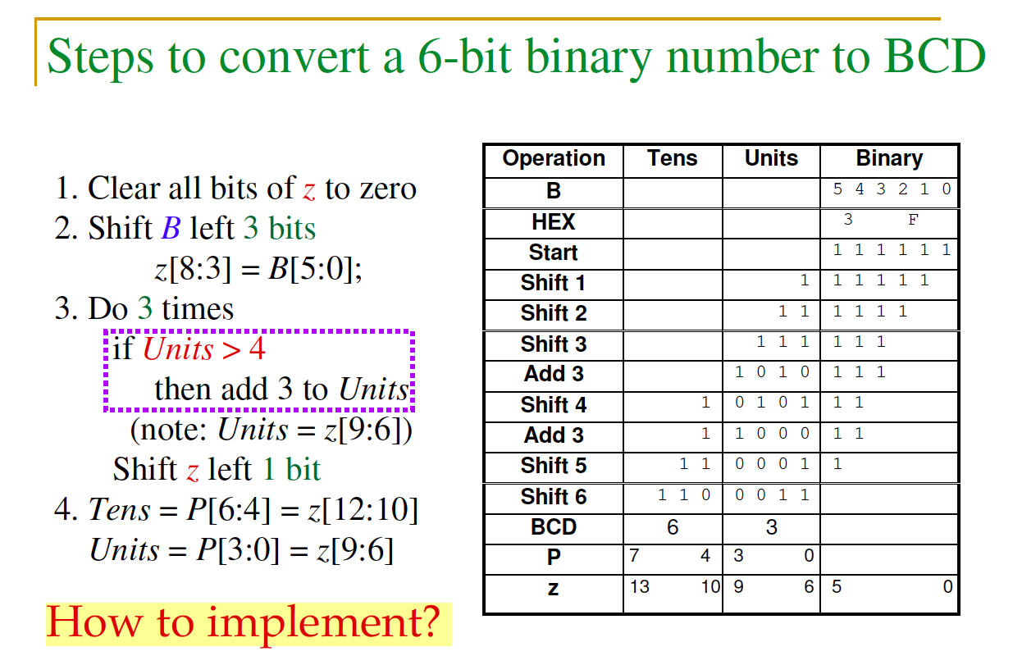
Algorithm 2

Slide 11
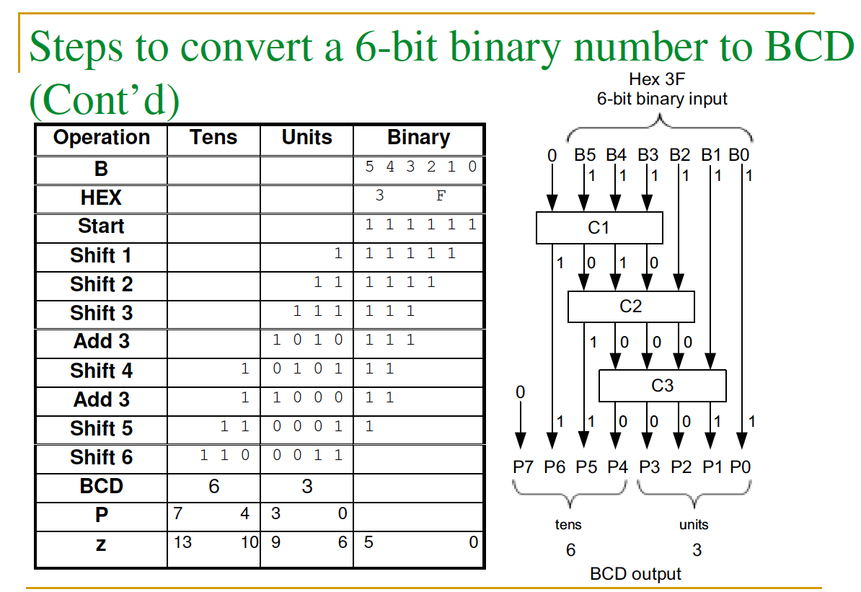

Slide 12
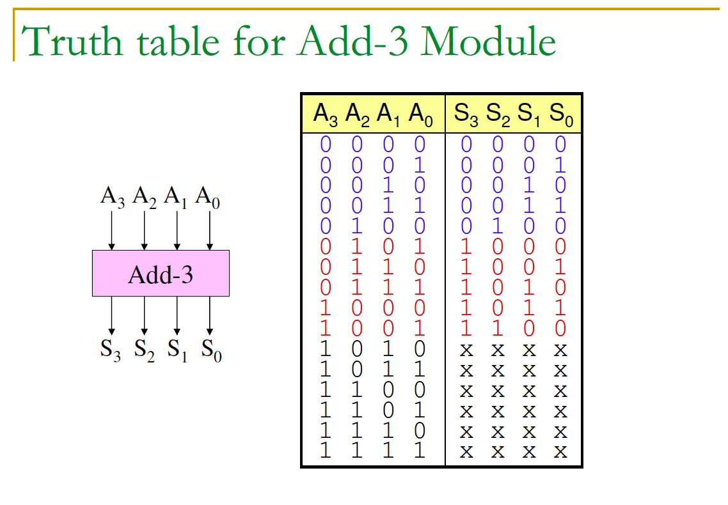
Conditional Add-3

Slide 13
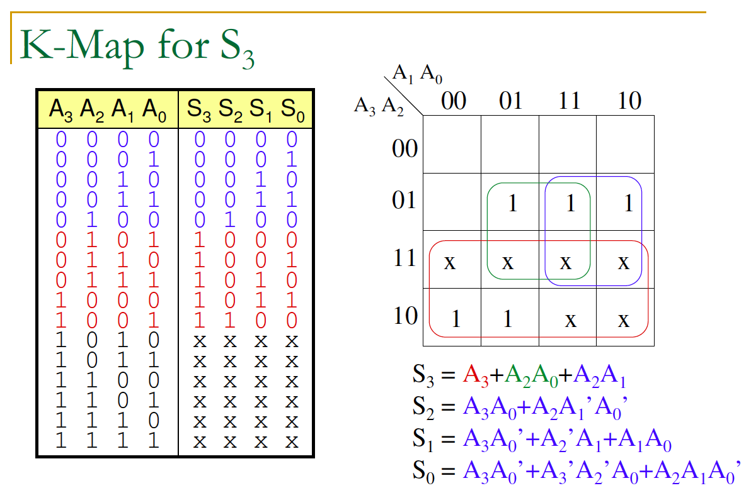

Slide 14
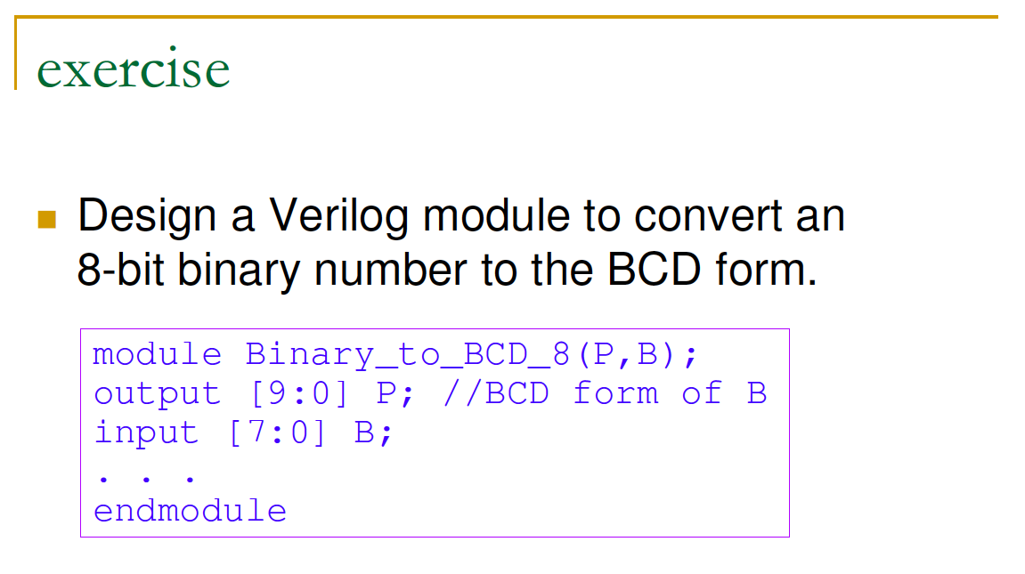

Slide 15
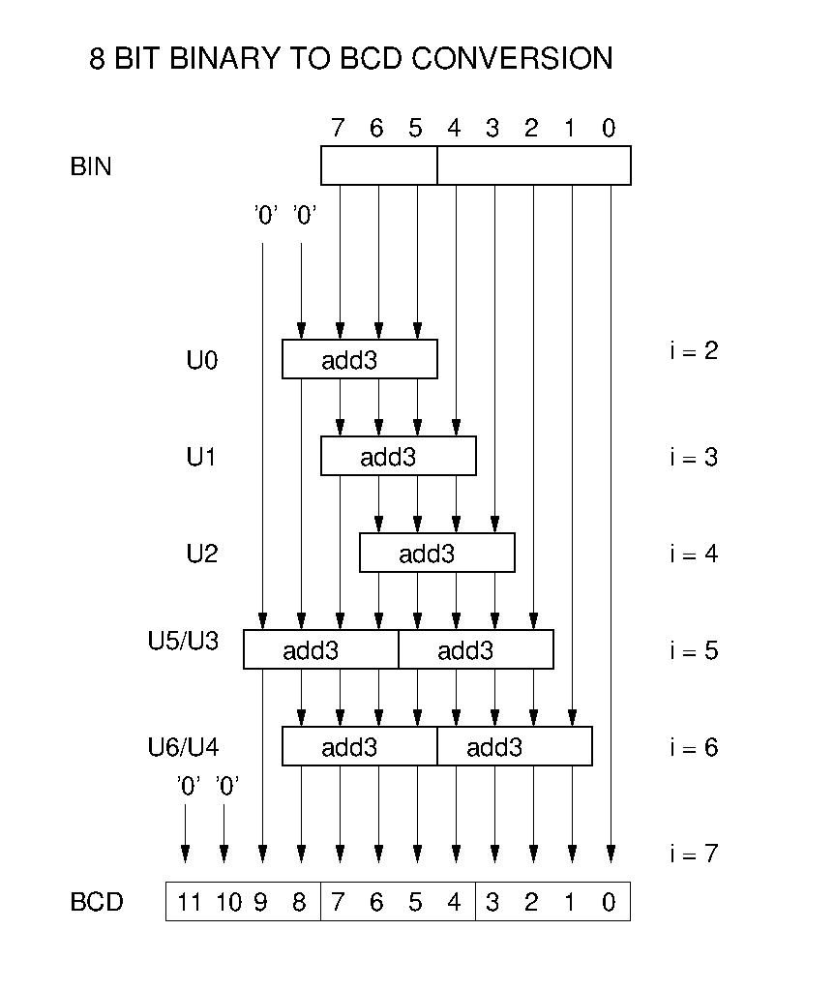
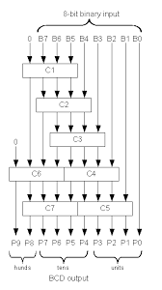

Slide 16
Q & A

Slide 17
Homework 3
(HW-2)
ALU function
(HW-1)
Binary-to-BCD Converter
X
Y
0000~0FFF(H)
X, Y = 0~2¹²-1(B)

Slide 18
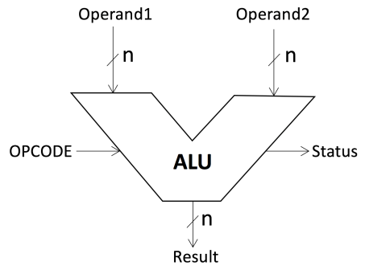
ALU Design
Design an 8-function ALU that takes two 13-bit numbers d1 and d2 and computes a 13-bit result out based on a 3-bit OPCODE signal. If result=0, Status has to output 1.
OPCODE | Function Output
3’b000 | a
3’b001 | a+b
3’b010 | a-b
3’b011 | a/b
3’b100 | a%b (remainder)
3’b101 | (a>b)
3’b110 | a>>1
3’b111 | a<<1
aclk

